Slide 1
The Cellular Organization of a Living Organism

Slide 2
Cell: basic Unit of life
Smallest unit of living matter
All cells have cell membrane, cytoplasm and genetic material but differ in shape, structure and functions
Able to carry out the processes of life like cellular respiration, reproduction, growth etc

Slide 3
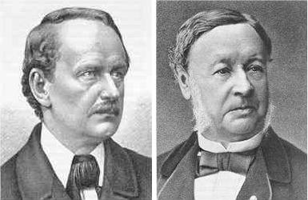
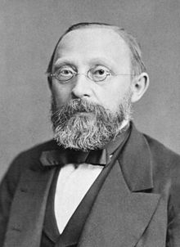
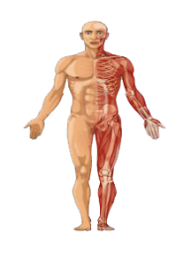
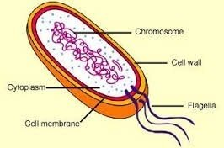
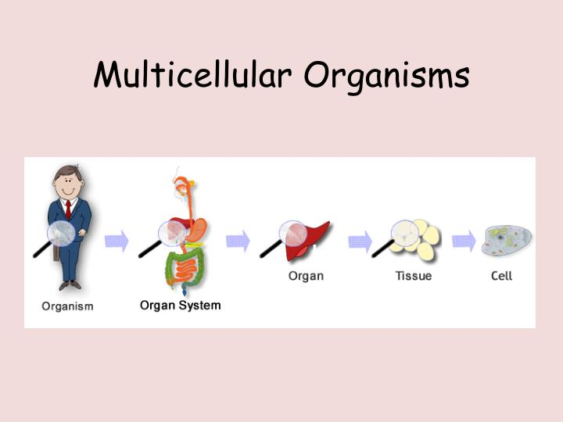
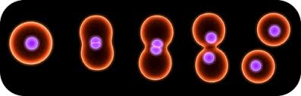
Cell theory
Cell theory was formulated in 1839.
This is usually credited to Matthias Schleiden,Theodor Schwann and Rudolf Virchow
Postulates
Unicellular Organism
Bacteria
Multicellular Organism
Human
All living organisms are made up of cells and their products.
Cells are basic building unit of life i.e., nothing smaller than cell can live independently.
New cells arises from the pre-existing cells by division

Slide 4
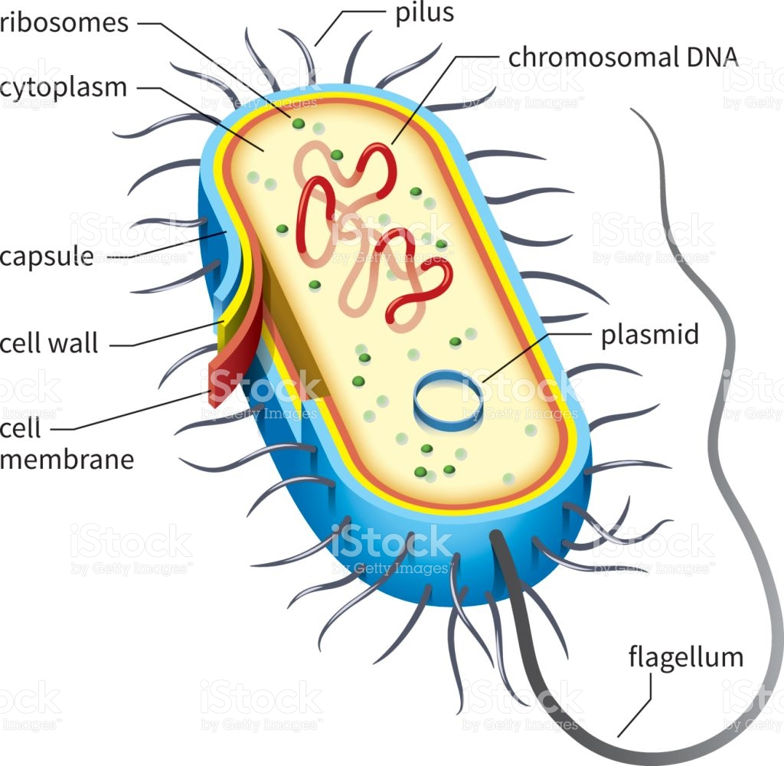
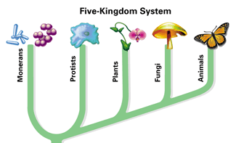
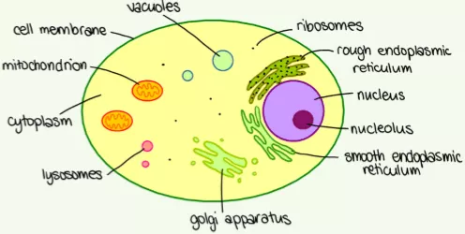
Structure of prokaryotic and eukaryotic cell
Living Things
Prokaryotic cell
Animalia
Monera
Protista
Plantae
Fungi
Prokaryotes
Eukaryotes
Bacteria
Protozoa, algae
Plant
Fungi
Animals
Eukaryotic cell

Slide 5
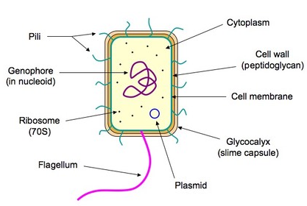
prokaryotic cell
Chromosomal DNA
Capsule

Slide 6
Cell wall: Maintains cell shape, structural support and protection against damage
Cell membrane: Provide protection and allows movement of substance from in and out of cells
Cytoplasm: Gel-like matrix composed of water, enzymes, nutrients, wastes etc. Site where cell functions (cell growth, metabolism, and replication) are carried out.
Naked DNA (in Nucleoid region): DNA organised into single circular chromosome, stores genetic information, passes on to daughter cell
Ribosome: Protein synthesis
Flagella: A slender whip like structure used for locomotion
Pili and fimbriae: Help in attachment to substrate
Structure some time present in prokaryotic cell
Plasmid: Extra chromosomal DNA. Contain antibiotic resistance gene. Used as vector for genetic engineering.
Capsule: Protect cell from antibiotics and dessication, considered a virulence factor
Notes:
A plasmid (also called a vector) is a small circular DNA molecule that replicates independently of the chromosomal DNA in bacteria.
In cloning, the plasmid molecules can be used to provide a “vehicle” in which to insert a desired DNA fragment. Modified plasmids are usually reintroduced into a bacterial host for replication. As the bacteria divide, they copy their own DNA (including the plasmids). The inserted DNA fragment is copied along with the rest of the bacterial DNA. In a bacterial cell, the fragment of DNA from the human genome (or another organism that is being studied) is referred to as foreign DNA to differentiate it from the DNA of the bacterium (the host DNA).
A slime layer is loosely associated with the bacterium and can be easily washed off, whereas a capsule is attached tightly to the bacterium and has definite boundaries.
The capsule is considered a virulence factor because it enhances the ability of bacteria to cause disease (e.g. prevents phagocytosis i.e., protect cells from engulfment by eukaryotic cells, such as macrophages)

Slide 7
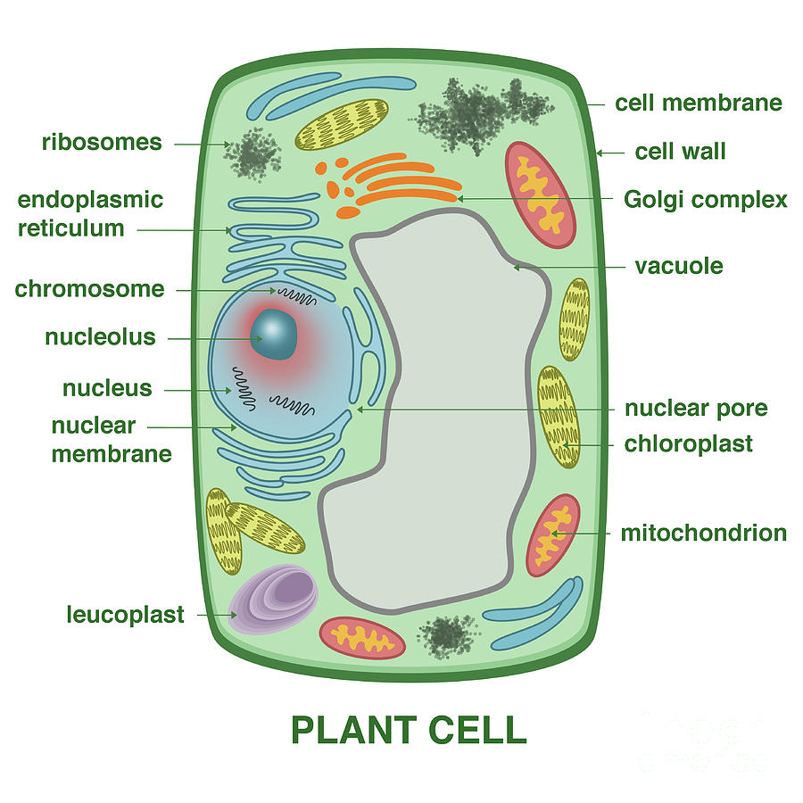
Structure and function of EUkaryotic cell
ANIMAL CELL

Slide 8
Cell membrane: Regulates passage of materials into and out of the cell.
Cytoplasm: Contents of the cell located between the plasma membrane and the nuclear membrane. Composed of water, salts, and proteins. Contains all organelles, cytoskeleton.
Nucleus: Control center of cell. Bounded by a double membrane with pores. Pores serve as a direct passage route for substances to leave the nucleus. It contains a liquid or nucleoplasm, where nucleolus (or nucleoli) and chromosomes are present.
Nucleolus: Involved in the assembly and synthesis of ribosomes.

Slide 9
DNA: Organised with proteins into chromatin. Condense to form multiple linear chromosomes during cell division.
Mitochondria: Called as “power house of the cells”. Breakdown fuel molecules for releasing ATP (the energy currency of cells).
Endoplasmic reticulum: Network of interconnected membranes. Production and processing of protein destined to be exported (RER), Synthesis of carbohydrates, lipids and steroid hormones as well as detoxification of a variety of poisons (SER).
Ribosome: Either free or associated with RER. Site of protein synthesis.

Slide 10
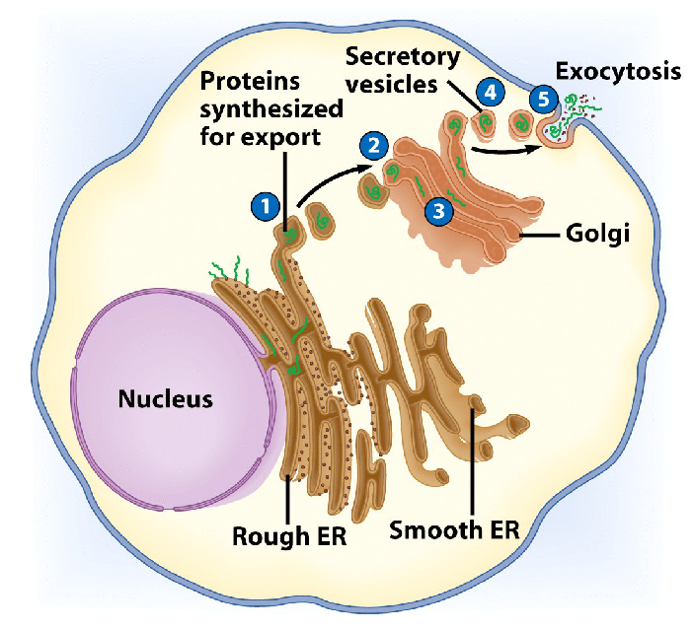
Golgi apparatus: Flattened stacks of membrane, likened to the cell's post office. Major function is modifying, sorting and packaging of proteins for secretion.
Lysosomes: Called as suicidal bags of the cell. Contain lytic enzymes. Play role in intracellular digestion, breakdown of old organelles and destruction of certain structures during development.

Slide 11
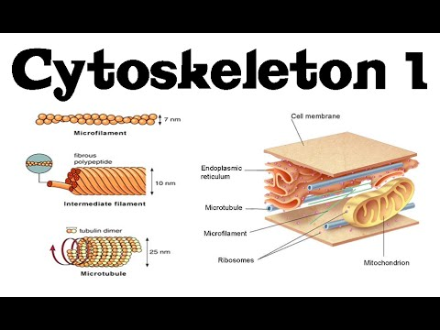
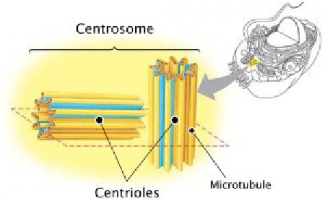
Cytoskeleton: Skeleton contained within cytoplasm. Helps in maintenance of cell shape, intracellular transport (movement of vesicles and organelles), cell motility (as in cilia or flagella) and cell division.
Centrosome and Centrioles: Centrosome contains two rod-like structures (made of microtubules) called centrioles that lie just above the nucleus. Play a role in formation of spindle apparatus during cell division in animal cells.
Notes:
MT - helps in chromosome movements during cell division
MF - helps in cleavage furrow formation during cell division

Slide 12
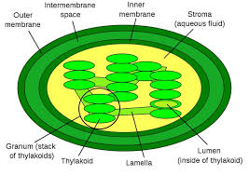
Vacuoles: Membrane bound storage sacs. More common in plants than animals. Acts as a reservoir for fluids and salts (can be water, food and wastes). Helps in providing turgidity to cell in association with cell wall.
Cell wall: Provides structural support and protection to cell. In combination with vacuole helps in controlling turgidity of the cell.
Chloroplast: Site of photosynthesis

Slide 13
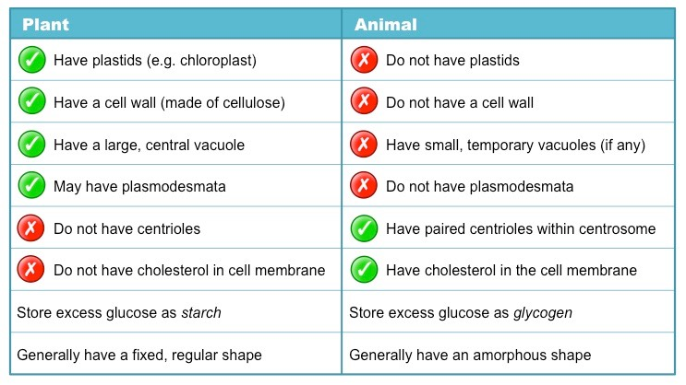
Difference between pLANT CELL and animal cell

Slide 14
Difference between prokaryotic and eukaryotic cell
Characteristics | Prokaryotic cell | Eukaryotic cell
Nucleus | Absent | Present
Chromosome | Single circular, Plasmid present | Many linear No plasmid
Membrane bound cell organelles | Absent | Present like mitochondria, ER
Pili, fimbriae, cilia, flagella | Pili, fimbriae (adhesion) flagella (motility) | Cilia,flagella (motility)

Slide 15
IMPORTANT QUESTIONS
What is a cell? Write down the important postulates of cell theory.
Discuss the evidence for cell theory.
Draw a well-labeled diagram of a prokaryotic / plant / animal cell and describe the major function of each structure.
Write down the major differences between prokaryotic and eukaryotic cell.
Write the major differences between plant and animal cell.

